Slide 1
Sentiment-Based Sales Optimization
Leveraging Customer Feedback to Enhance Satisfaction and Drive Sales

Slide 2
Results and Findings
Results and Findings
Data Integrity & Model Parameters
No missing values in features and target.
Data Split: 75% training, 25% testing.
Best Model Parameters:
C: 10 (moderate regularization)
Penalty: 'l1' (L1 regularization for sparse models)
Model Performance
Accuracy: 93.03%
Precision: 96.77%
Recall: 94.65%
F1 Score: 95.70%
Classification Report
Not Recommended (Class 0):
Precision: 0.78
Recall: 0.86
F1-Score: 0.82
Recommended (Class 1):
Precision: 0.97
Recall: 0.95
F1-Score: 0.96
Confusion Matrix and Key Insights
Confusion Matrix
True Negatives (TN): 911
False Positives (FP): 153
False Negatives (FN): 256
True Positives (TP): 4552
Key Insights
High Accuracy: 93.03%
Strong Precision and Recall: Effective identification of recommendations.
Balanced Performance: F1 Score of 95.70% combines precision and recall.
Class Distribution:
Class 0 (Not Recommended): Precision: 0.78, Recall: 0.86
Class 1 (Recommended): Precision: 0.97, Recall: 0.95

Slide 3
Visualizations and Recommendations
Visualization Confirmation
Confusion Matrix: High TP and TN values, few FP and FN values.
Bar Plot (TP, TN, FP, FN): Visual representation of prediction distribution.
Overall Recommendations
Target Marketing:
Focus on age group 30-39, highlight positive feedback.
Develop strategies to engage the under-20 age group.
Product Development:
Enhance and promote high-rated products in popular departments.
Address issues in departments with higher negative sentiment.
Customer Engagement:
Encourage detailed reviews from customers.
Utilize insights from word clouds in marketing materials.
Conclusion:
The project offers valuable insights for improving product offerings, customer satisfaction, and marketing strategies through advanced analytics and NLP techniques.

Slide 4
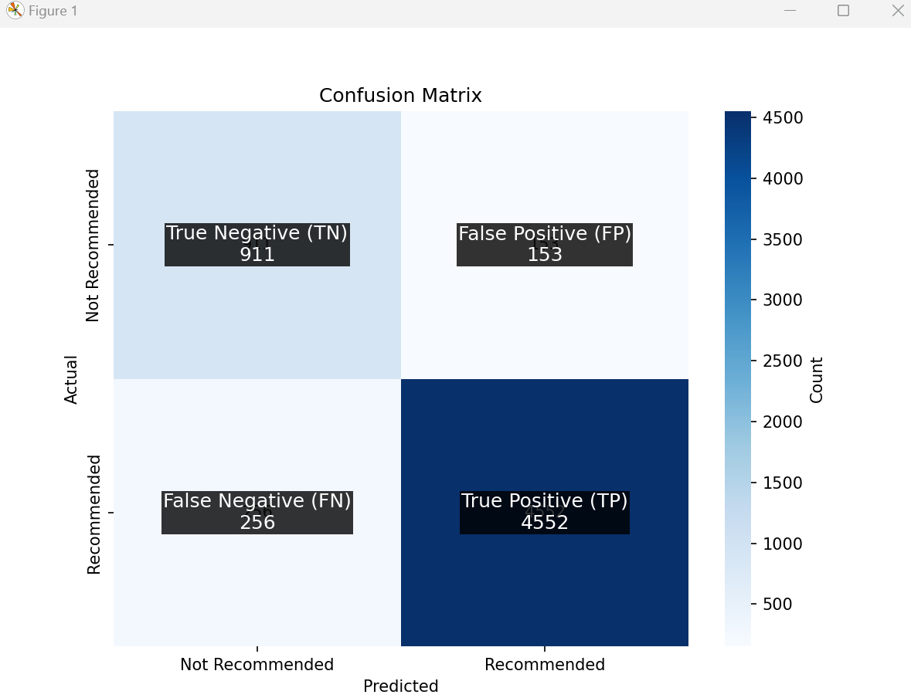
Confusion Matrix

Slide 5
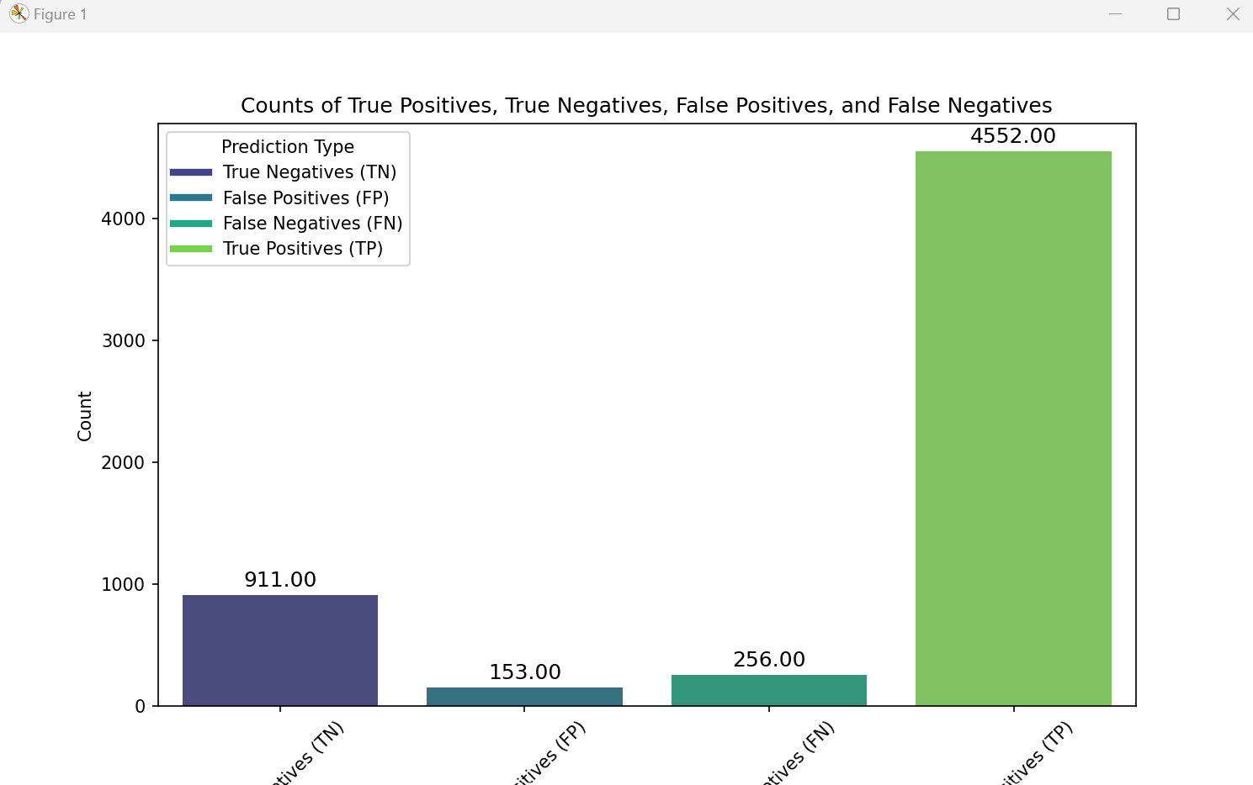
Bar Chart Representing Matrix

Slide 6
Key Findings from Power BI Report

Slide 7
Sentiment Analysis by Demographics
Demographic Insights: Our analysis revealed significant insights into customer demographics and their behavior. The 30-39 age group showed the highest engagement and satisfaction levels, with detailed reviews and positive sentiments. In contrast, the under-20 age group exhibited lower engagement and less positive sentiment. These insights suggest focusing marketing efforts on the 30-39 age group while developing strategies to increase engagement among younger customers.

Slide 8
Sentiment Analysis by Demographics
Review Length and Sentiment Analysis: Detailed review length analysis indicated that customers in the 30-39 age group tend to write longer, more informative reviews, particularly in the Outerwear and Dresses divisions. Sentiment analysis further highlighted that common positive attributes include "fit," "quality," "comfortable," and "stylish." These findings emphasize the importance of maintaining high standards in these areas and using them as key selling points in marketing materials.

Slide 9
Key Insights
Sentiment Analysis by Demographics
Positive Feedback Distribution and Department Performance: The analysis of positive feedback distribution across departments showed that Tops and Dresses received the highest positive feedback, indicating high customer satisfaction. Conversely, departments like Shoes and Accessories had higher instances of negative sentiment, suggesting areas for improvement. Promoting high-rated products in well-performing departments and addressing issues in lower-performing ones can enhance overall customer satisfaction and drive sales.

Slide 10
Overall Recommendations
Target Marketing:
Focus on the 30-39 age group and emphasize positive customer feedback in your marketing campaigns.
Develop strategies to engage the under-20 age group, perhaps with social media campaigns or youth-oriented promotions.
Product Development:
Continue to enhance and promote high-rated products in popular departments like Dresses and Accessories.
Address issues in departments with higher negative sentiment to improve overall customer satisfaction.
Customer Engagement:
Encourage detailed reviews from customers to gain deeper insights. Offer incentives for leaving comprehensive feedback.
Utilize word cloud insights to ensure that the most valued product attributes are highlighted in marketing materials.
These updated insights and recommendations provide a nuanced view of customer demographics and satisfaction, helping us to make data-driven decisions to boost customer engagement and sales.

Slide 11
Thank You
Valarmathi Ganessin

